Slide 1
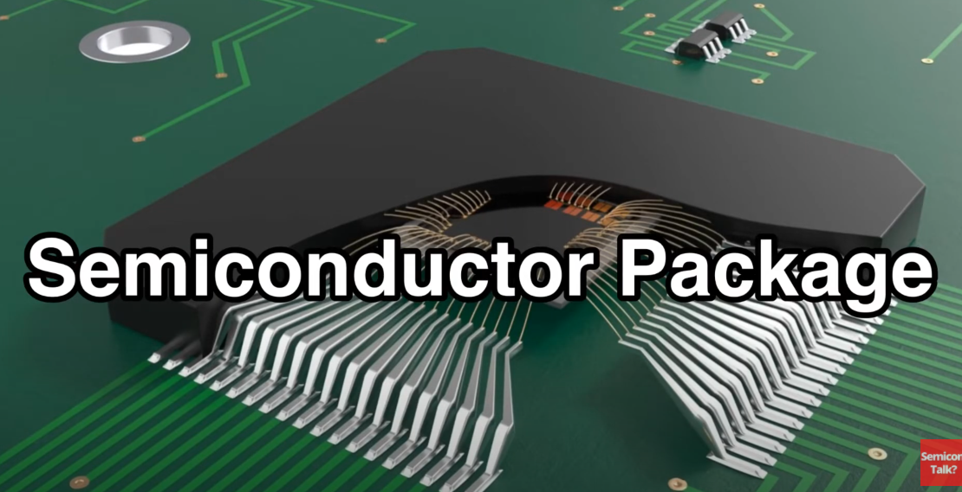
Packing

Slide 2
Why need to package
1) Protect the chip from damage caused by mechanical stress, chemical erosion,etc
2) Connect chip with outside electronics product (through pins/balls)

Slide 3
Design-> foundry -> packaing
Design (AMD,Apple.. Also called fabless company)
Foundry (TSMC, Globalfoundry. Produce the wafer only)
Packing (AST,Amkor, companies also called outsourced assembly and test companies)
Notes:
Companies like Intel, Texas instruments do all the things: design, manufacture and packge

Slide 4
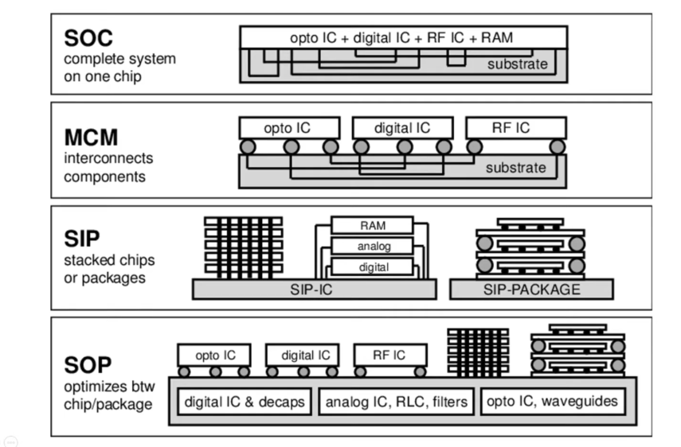
SCM vs MCM
Notes:
Need to explore for more detail of he design

Slide 5
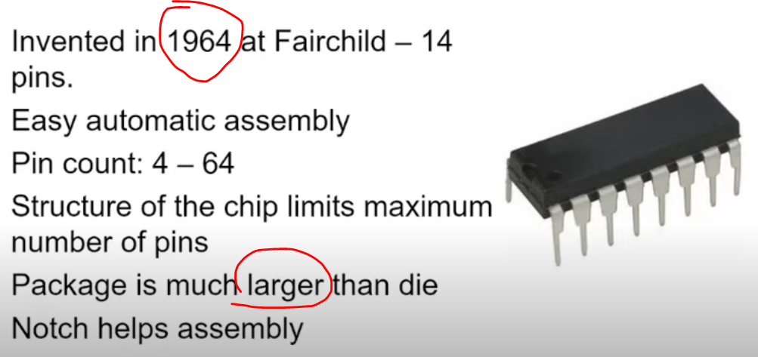
DIP (dual inline package)

Slide 6
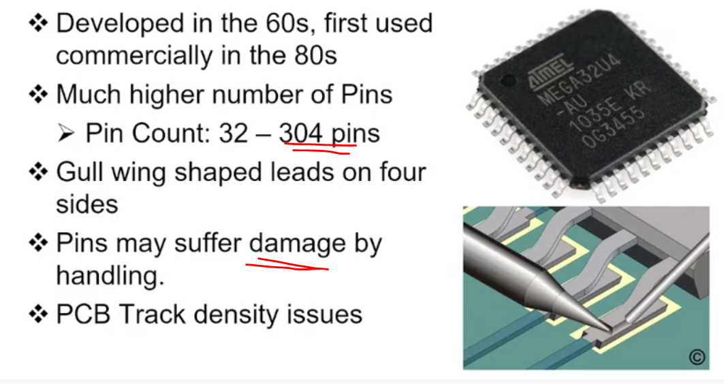
QFP(quad flat package)

Slide 7
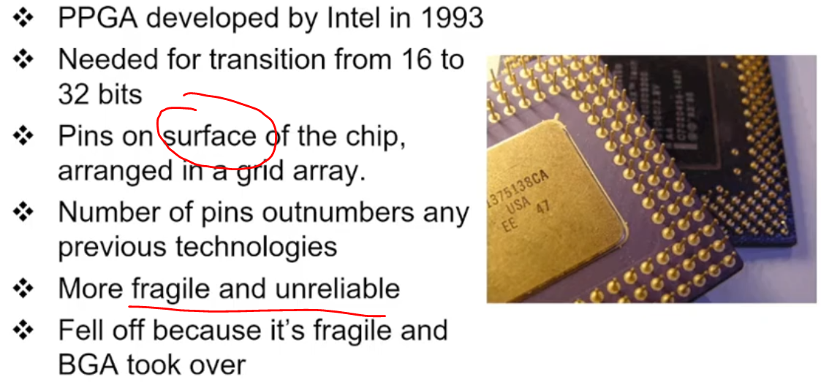
PGA( Pin Grid Array)

Slide 8
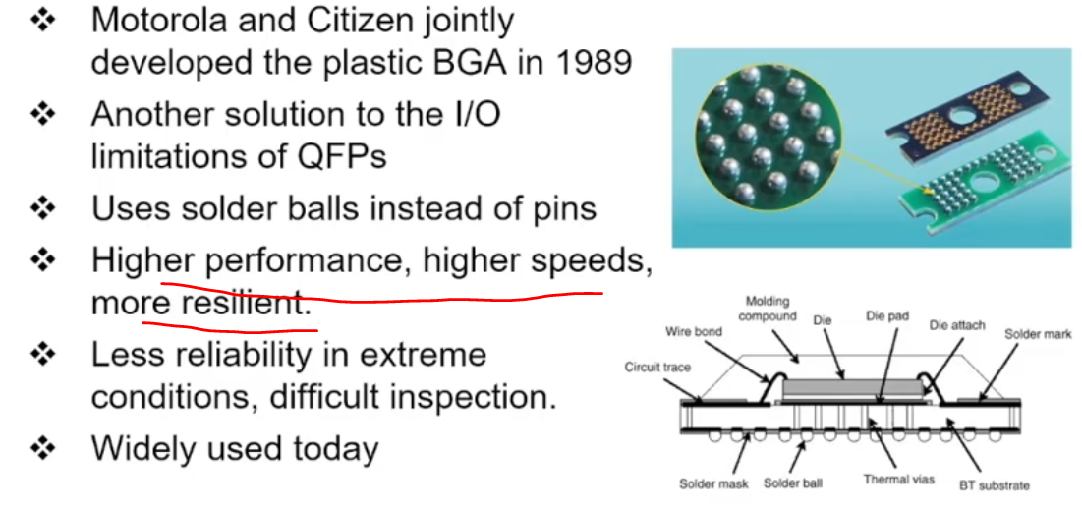
BGA (Ball Grid Array)
1) Shorter leads, better performance and speed
2) Smaller inductance better signal

Slide 9
Part3

